Slide 1
St. Paul’s Catholic Primary School
POTENTIAL TO RENT FOR 0-2 PROVISION

Slide 2
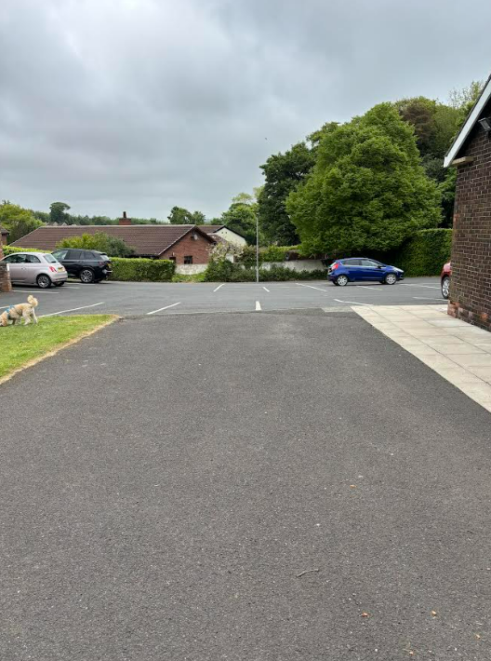
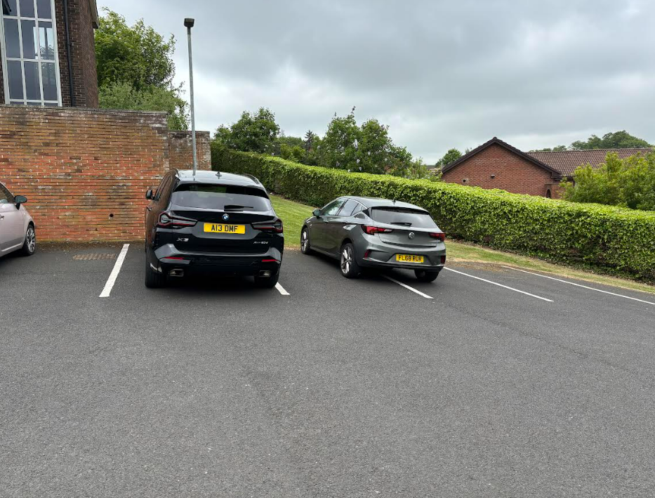
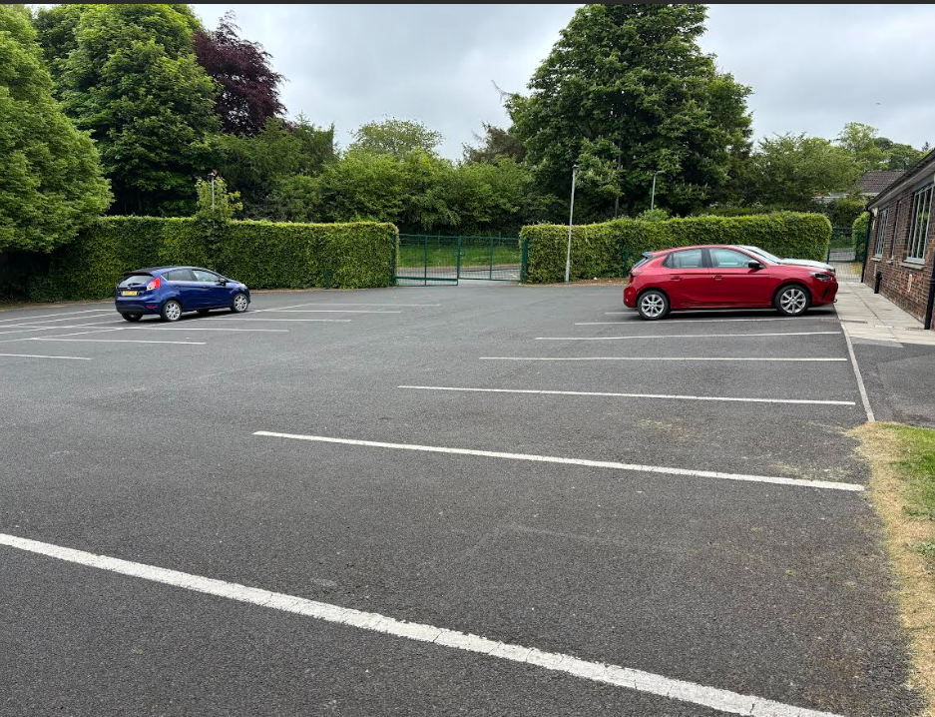
EXTERNAL AREA 1: Private car parking with 25 marked spaces. Secure, lockable gates.
CAR PARKING: approx. 26m x 25m
Classrooms are next to a secluded car park at the rear of the building with direct access to the rentable area.
Car park will hold 25 cars.
Notes:
CAR PARKING: approx. 26m x 25m
Classroom 2 is nearest a secluded car park at the rear of the building with direct access to the rentable area.
Car park will hold 25 cars.

Slide 3
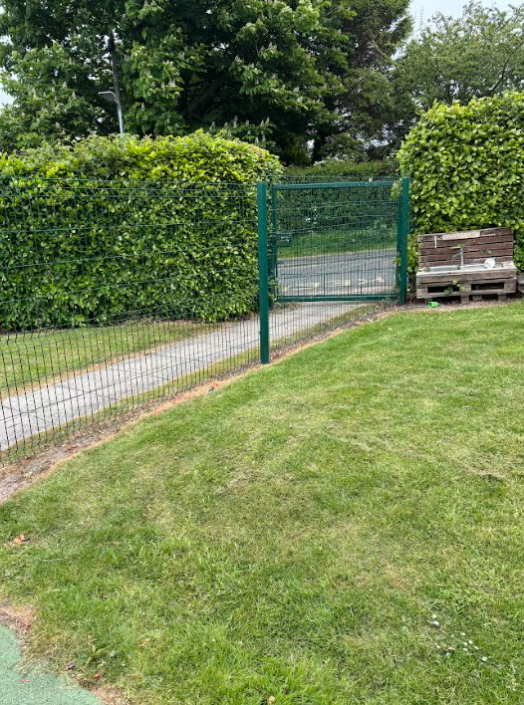
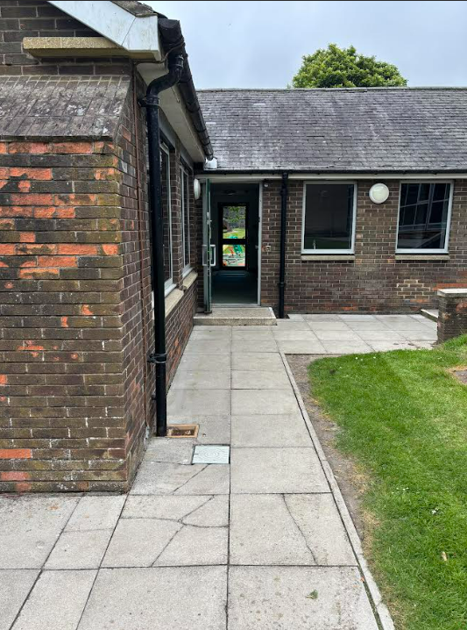
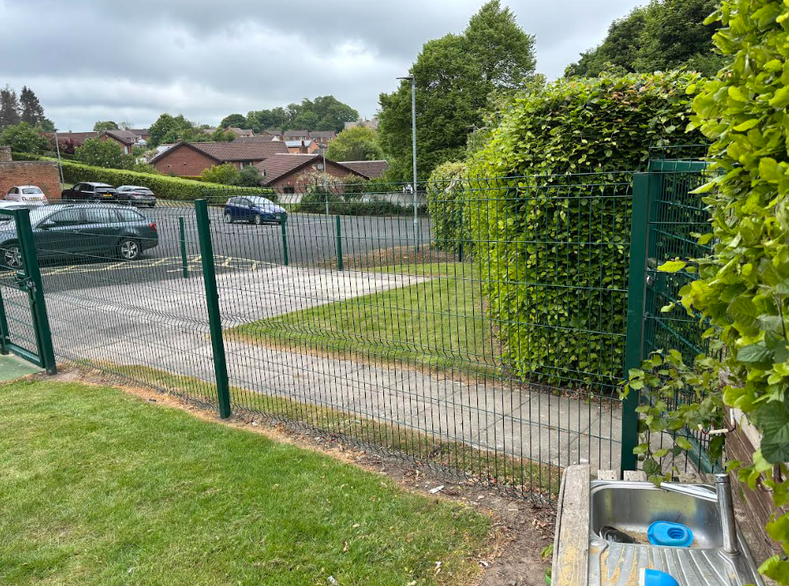
ENTRANCES / EXITS: Choice of two entrances/exits – one to car park and one onto Springfield Road. The latter has external gates and a pathway with a further gate.
Path approx. 6m x 1.5m
Notes:
Path approx. 6m x 1.5m

Slide 4
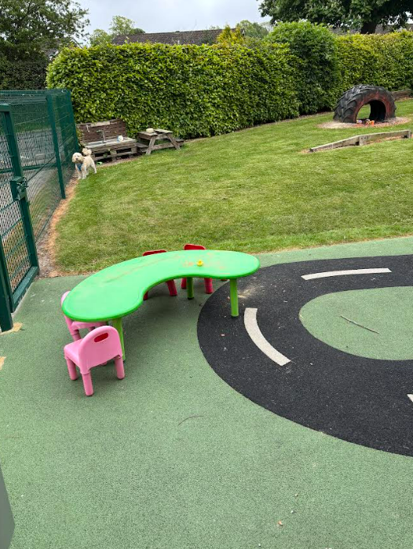
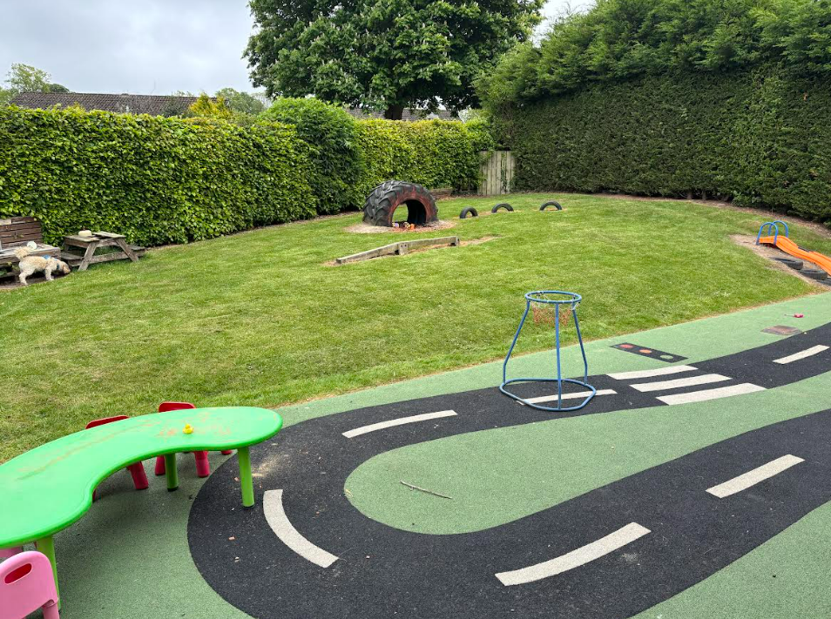
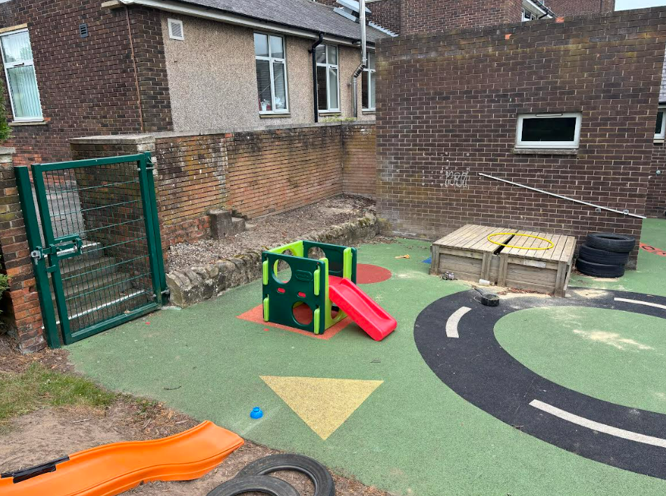
OUTSIDE PLAY AREA: Well developed area with fencing. Grassed area. Soft surface area. Flower bed/veg patch. Fitted play equipment – sand pit / slide / tyre climb/mud kitchen
Grassed area approx. 16m x 14m
Soft surface area approx. 16m x 5m
Easily accessible from both rooms is an outdoor area.
High fencing
Padlocked gate to short path that can be used to access school field. Secure padlocked gate at end of path onto Springfield Road for pedestrians to use.

Slide 5
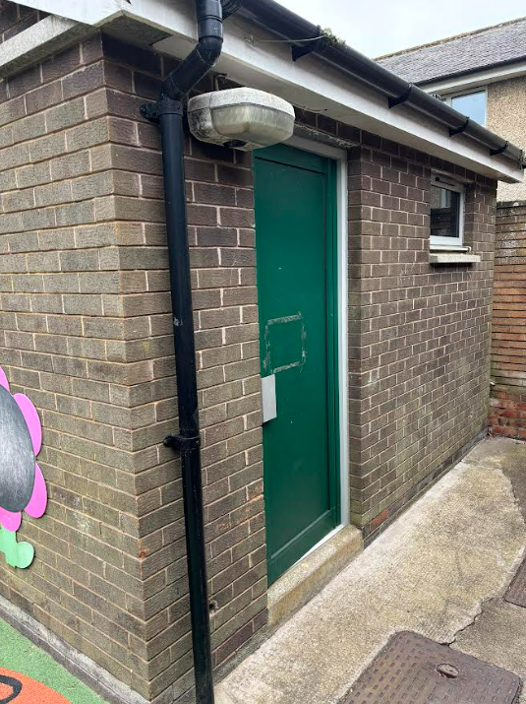
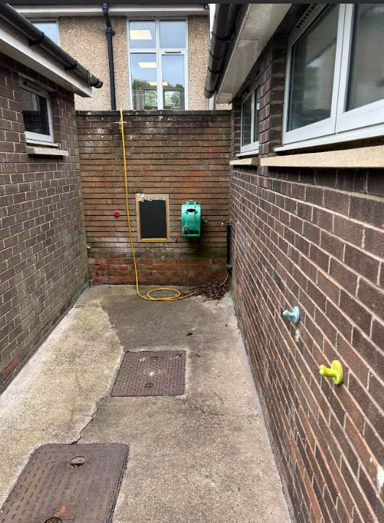
EXTERNAL STORAGE: Large self contained brick storage building with external access and locking door. Wall mountable hose pipe
Outdoor concrete storage area for large toys and equipment

Slide 6
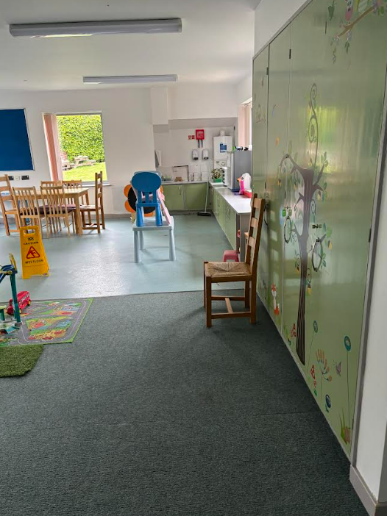
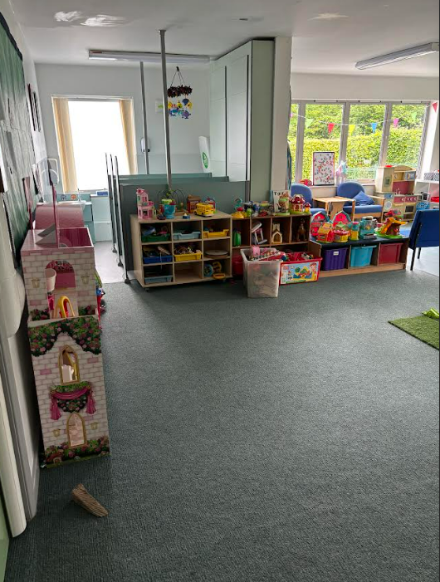
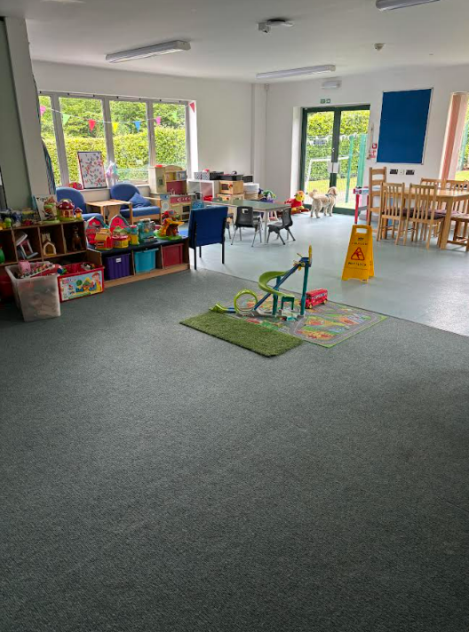
CLASSROOM 1: Large open space – half wet flooring / half carpet. Double doors to garden area. New boiler fitted 2025.
Carpet area approx. 4m x 7m
Wet area approx. 5m x 7m
Toilet area approx. 2.5m x 2.5m consisting of two toilets, one changing area and one sink.
Sink and counter area. Four built in storage cupboards
One door into classroom 2
Purpose built toddler sized toilets – two cubicles and sink area.
Fold down baby changing unit

Slide 7
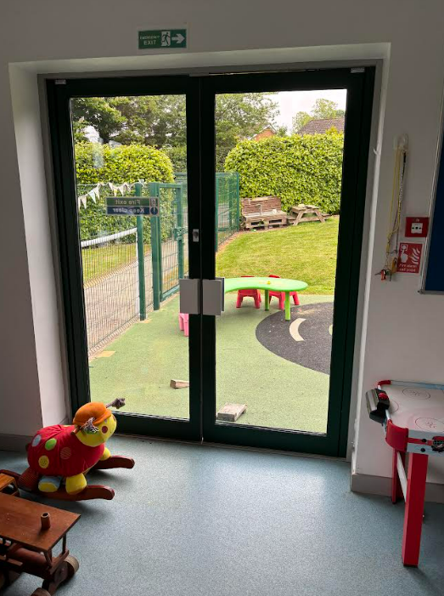
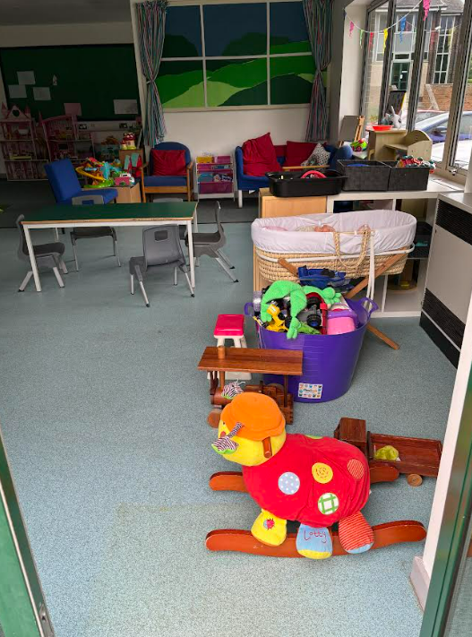
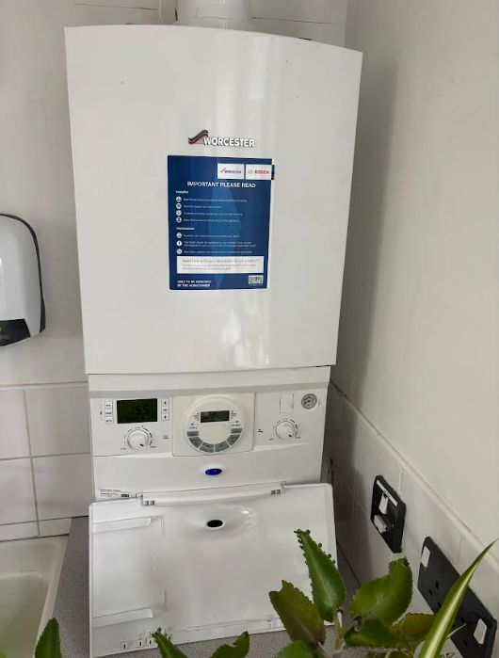
CLASSROOM 1: further photos

Slide 8
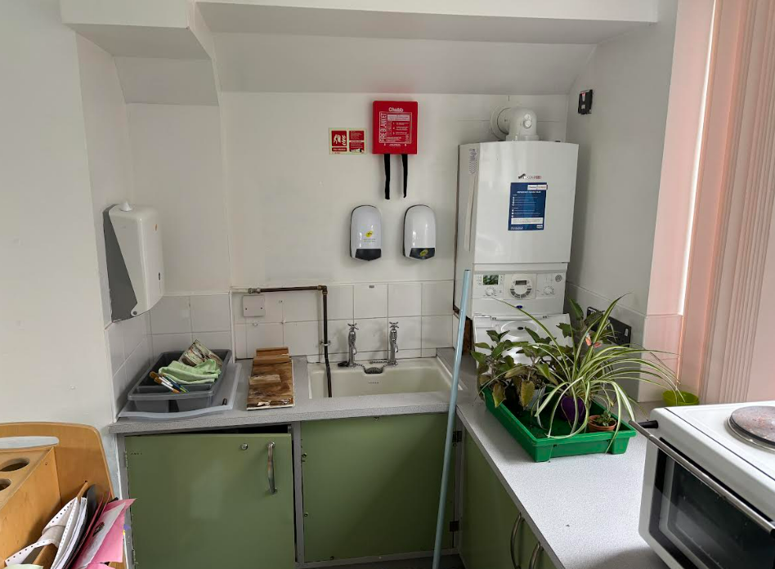
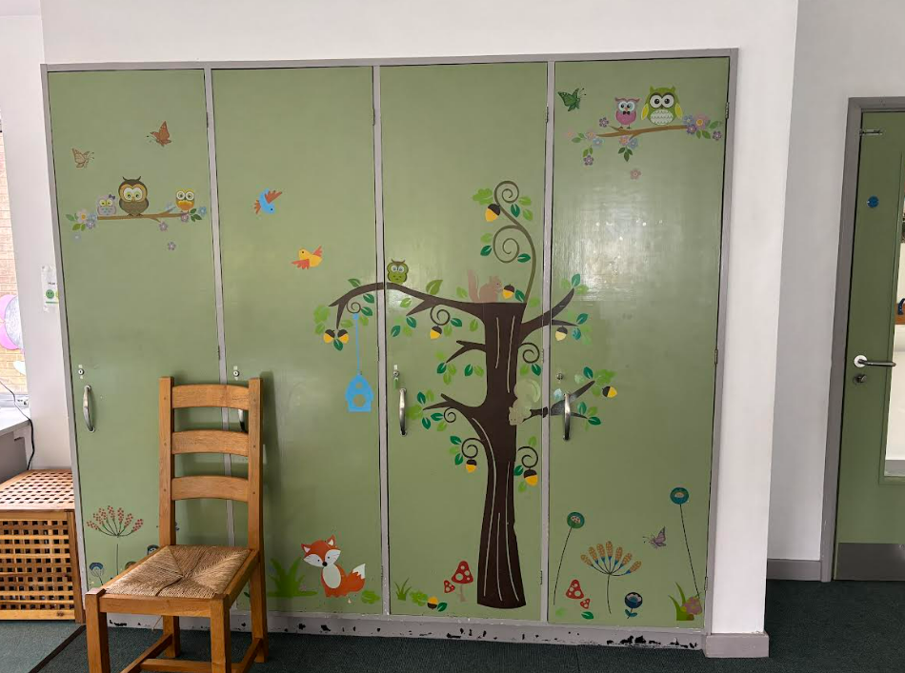
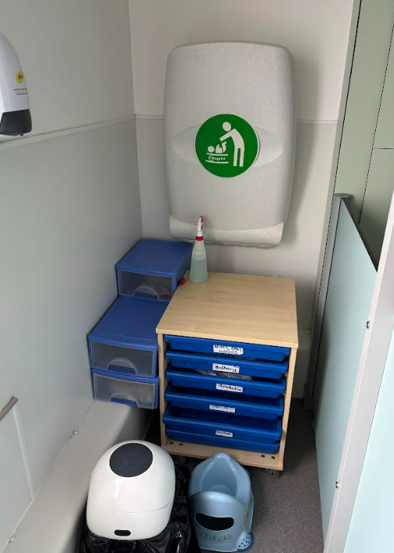
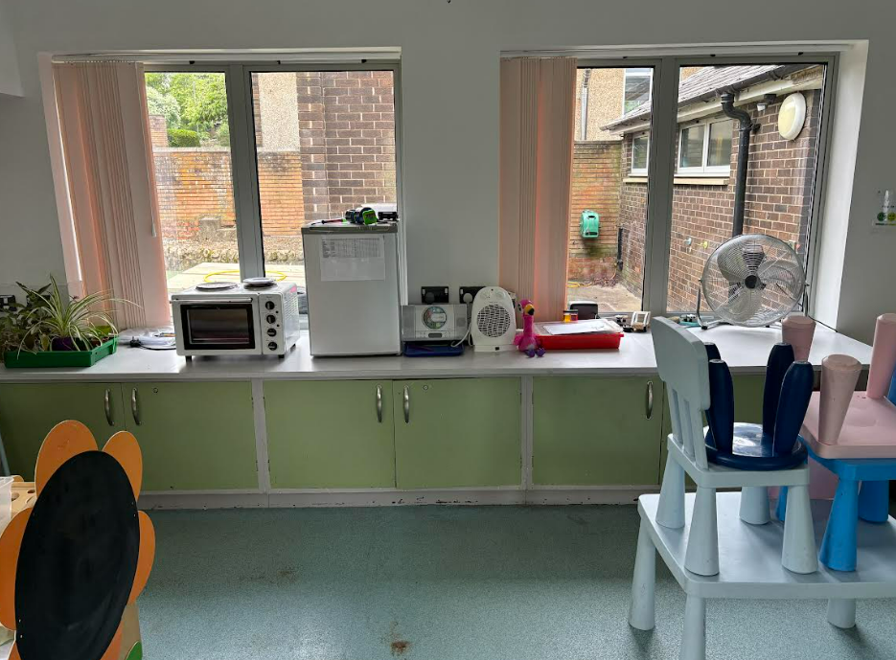
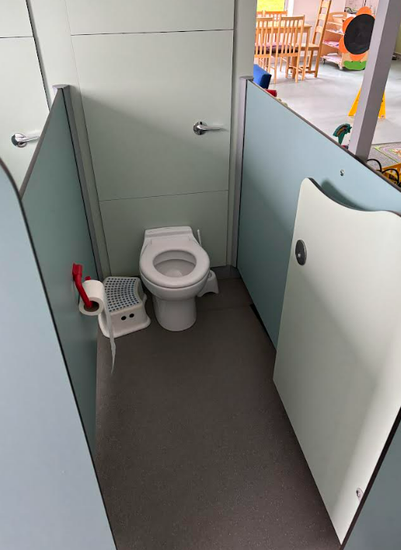

Slide 9
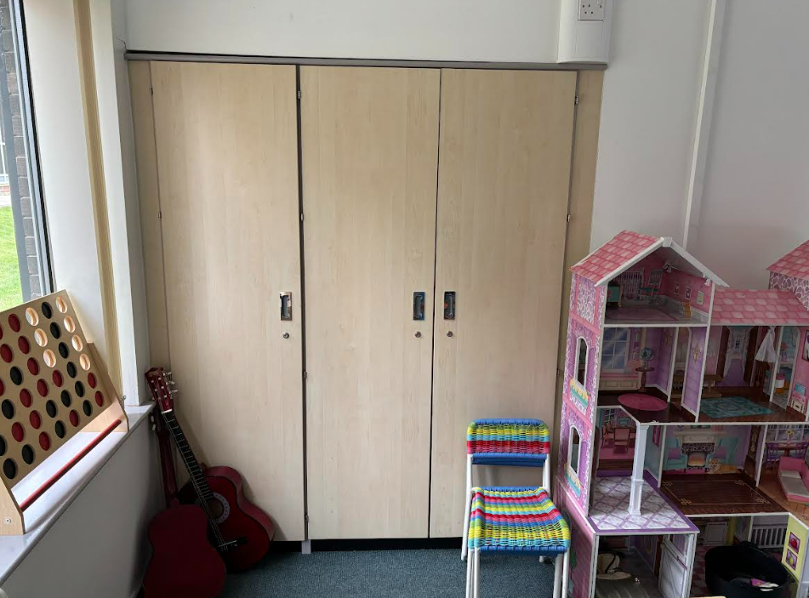
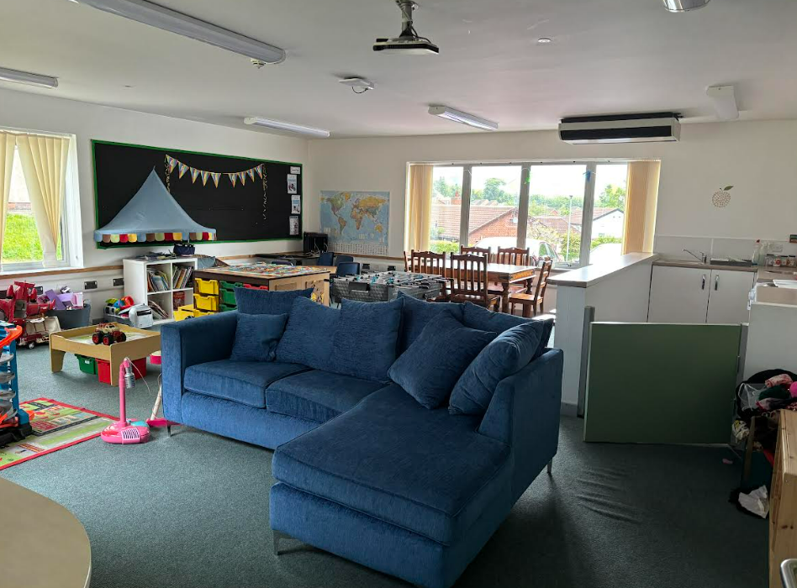
CLASSROOM 2:Large open space – all carpet. Secure kitchen area with breakfast bar. Kitchen has full sized cooker with oven, two sinks, dishwasher, fridge and built in storage units
Carpet area approx 7.5m x 5m
Kitchen area approx. 2m x 4m

Slide 10
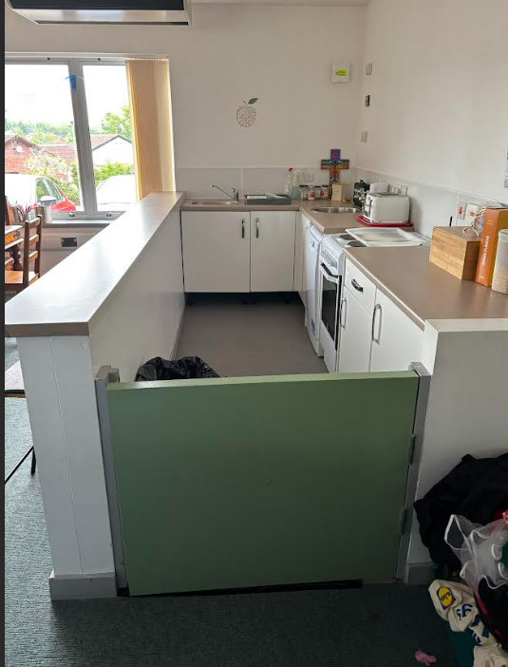
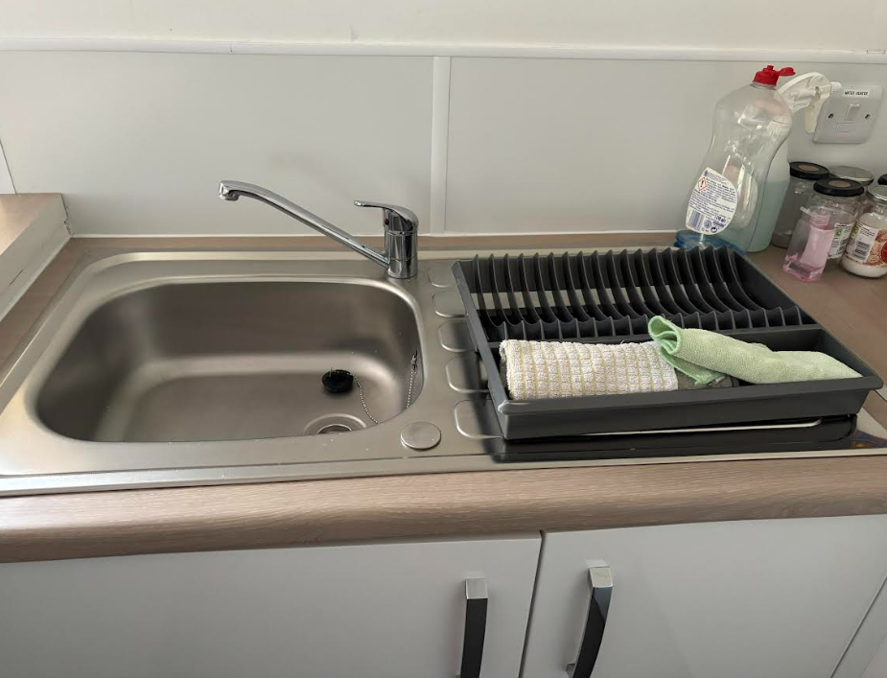
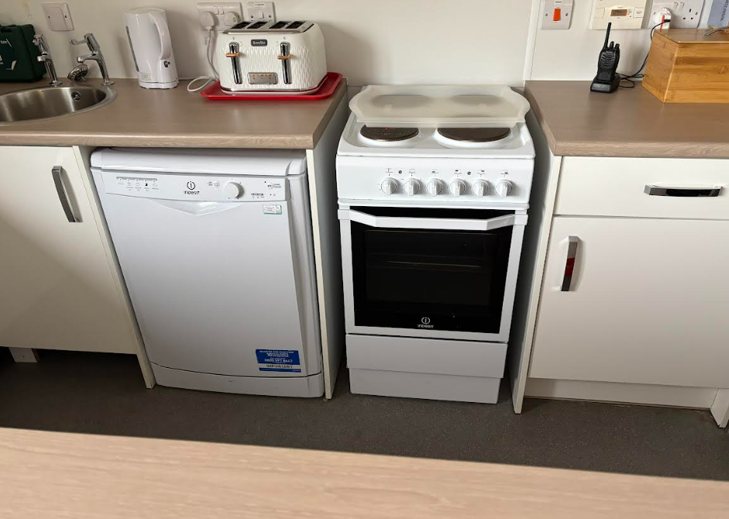
CLASSROOM 2: further photos

Slide 11
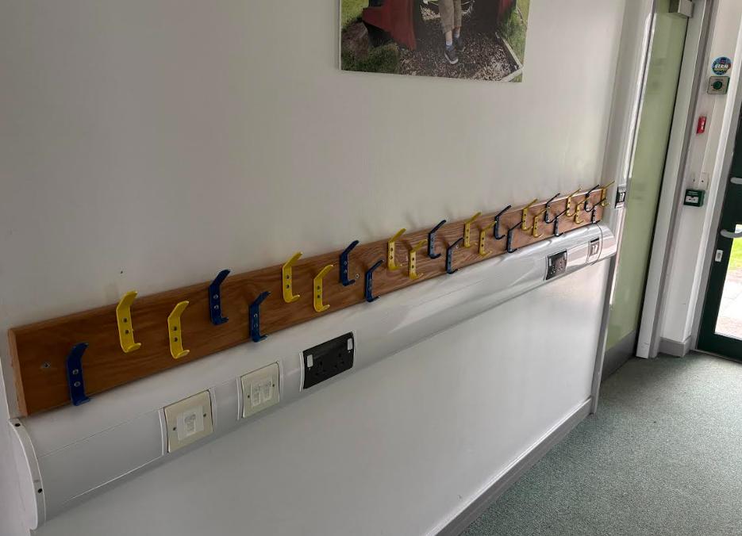
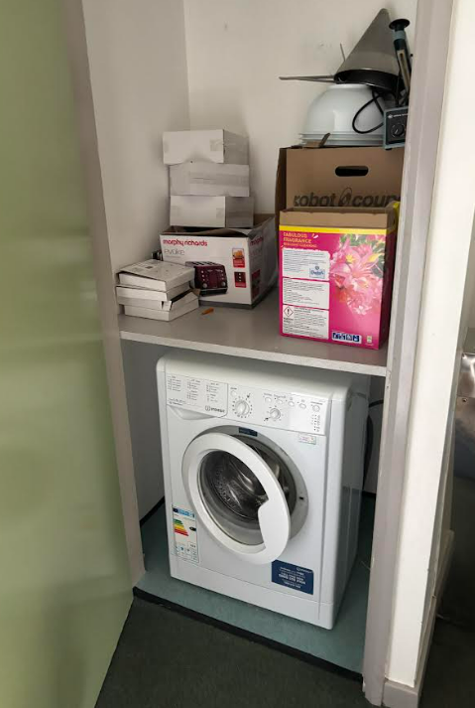
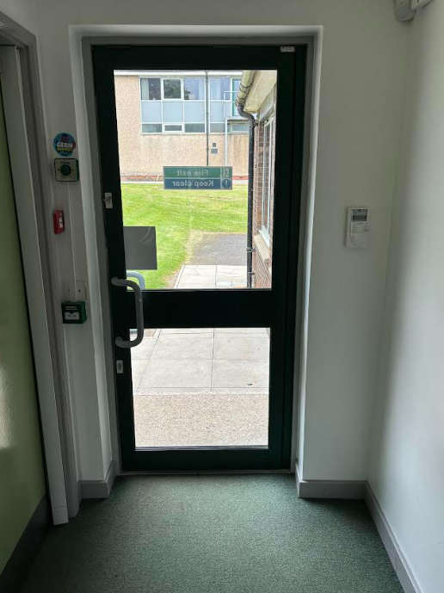
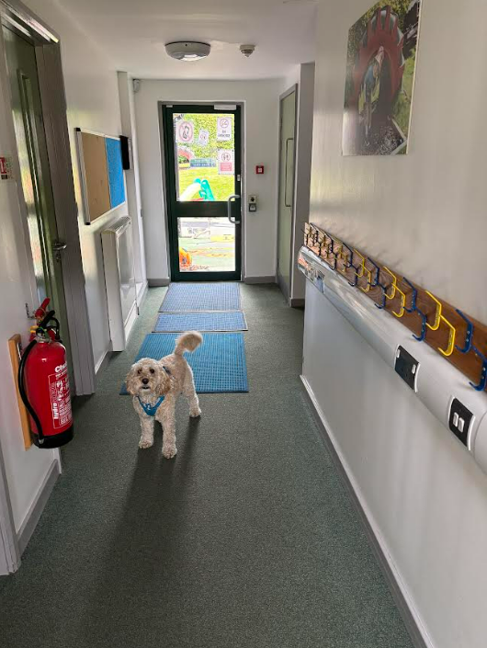
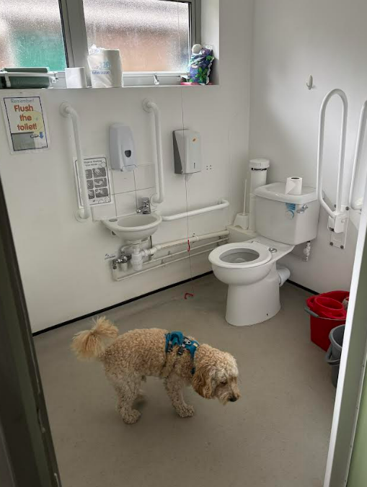
CORRIDOR 1: Links both classrooms. Has access to both car park and secure play area at each end. Cupboard in corridor holds a washing machine. Cloakroom pegs in corridor. Two adult toilets – both with disabled access. One with fold down baby change facility.
Corridor approx. 6.5m x 1.5m
Notes:
Corridor approx. 6.5m x 1.5m

Slide 12
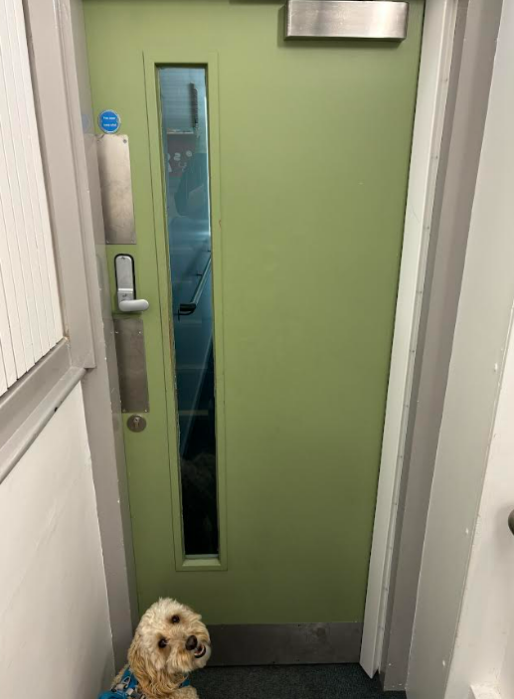
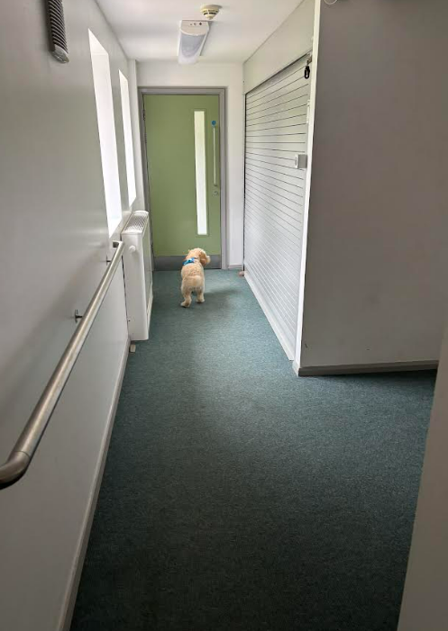
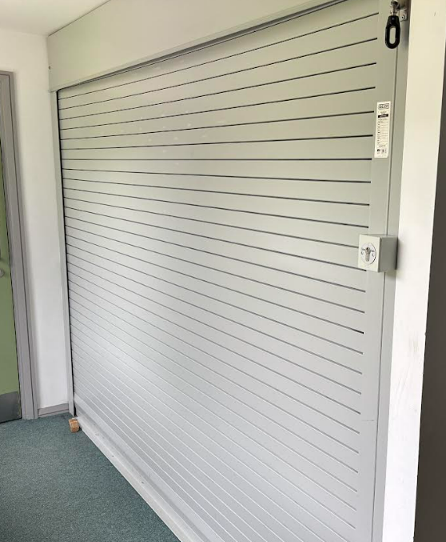
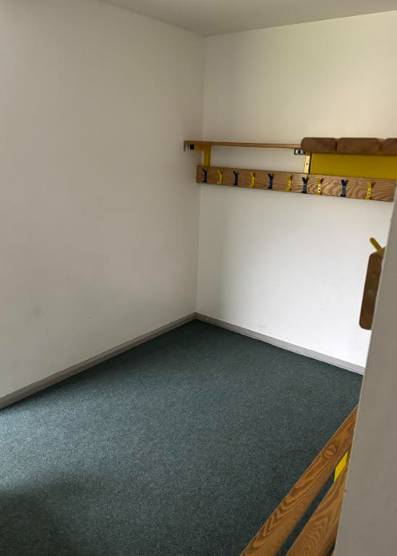
CORRIDOR 2: Cloakroom area that could be turned into a staff area for breaks/PPA/ office etc. Large electric shutter cupboard for storage Door into main school hall has coded lock fitted.
Corridor approx. 6.5m x 1.2m
Cloakroom space approx. 2m x 2m
Shutter cupboard approx. 2.5m x 2m

