Slide 1
Early Years Short Term Additional Resource
2025 - 2026
This guidance supports Northumberland Early Years providers to understand how to apply for Early Years Short Term Additional Resource (EYSTAR)

Slide 2
Panel Dates and Documentation Deadlines
Blank copies of all documentation can be downloaded from the Northumberland Education website https://northumberlandeducation.co.uk/sendsupport/
EYSTAR panel date | Deadline for documentation | Additional Information
08.10.25 | 26.09.25
12.11.25 | 24.10.25
10.12.25 | 28.11.25
14.01.26 | 19.12.25
11.02.26 | 30.01.26
11.03.26 | 27.02.26
01.04.26 | 20.03.26 | Funding will be paid at new rates
06.05.26 | 24.04.26 | Last panel for new applications and those children moving to reception
10.06.26 | 22.05.26 | 6 weeks worth of funding
08.07.26 | 26.06.26 | 1 week worth of funding

Slide 3
Preparing for an EYSTAR Application
You must request inclusion support and have received a visit from an EY Inclusion Consultant (EYIC) before applying. The EYIC will have discussions with you based on the following points, and whether an application is appropriate: How you have consulted the Early Years Ordinarily Available Provision (OAP) document and considered whether all elements of universal support are embedded within practice, and that the child you are requesting additional funding for requires over and above this. How you have considered (and applied for) and have a thorough understanding of all available funding streams (i.e. base rate, notional, EYPP, DAF) and how they are currently being used. That you have completed at least one cycle of targets and monitored its impact and have in place a new cycle of targets, showing current targets which have not yet been reviewed. That you have completed a recent assessment of the child using the Northumberland School Readiness Passport (School Readiness Checker and/or SEND Support Checker). That you have completed the 'All About Me' (and/or SEND Support All About Me) on the School Readiness Passport, or have uploaded your own version of this information to the documents section. Whether the child is accessing their full Early Years entitlement, and if not that you can provide evidence of a plan which outlines (in agreement with parents/carers) how the child's hours will increase with a goal of them being able to access their full entitlement within a reasonable timescale.

Slide 4
Completing an EYSTAR Application
Ensure the following elements (where relevant) of the School Readiness Passport are up to date | Upload the following (where relevant) to the 'documents' section of the School Readiness Passport
Child details (incl. correct identification of funding stream)
All About Me including: SEND Support 2 Year Old Progress Integrated Review | Own version of All About Me Own version of 2 year old Progress Integrated Review
School Readiness Checker (most recent) and/or SEND Support Checker (completed within 6-8 weeks of the panel date)
Actions identifying which specific strategies are in place to support the child. Refer to the Early Years Ordinarily Available Provision for appropriate strategies.
 | Documents including: Reports from professionals involved with the child Family views document At least one cycle of reviewed targets (identifying the role of the adult) A current cycle of targets (not yet reviewed) Provision map (group applications only)

Slide 5
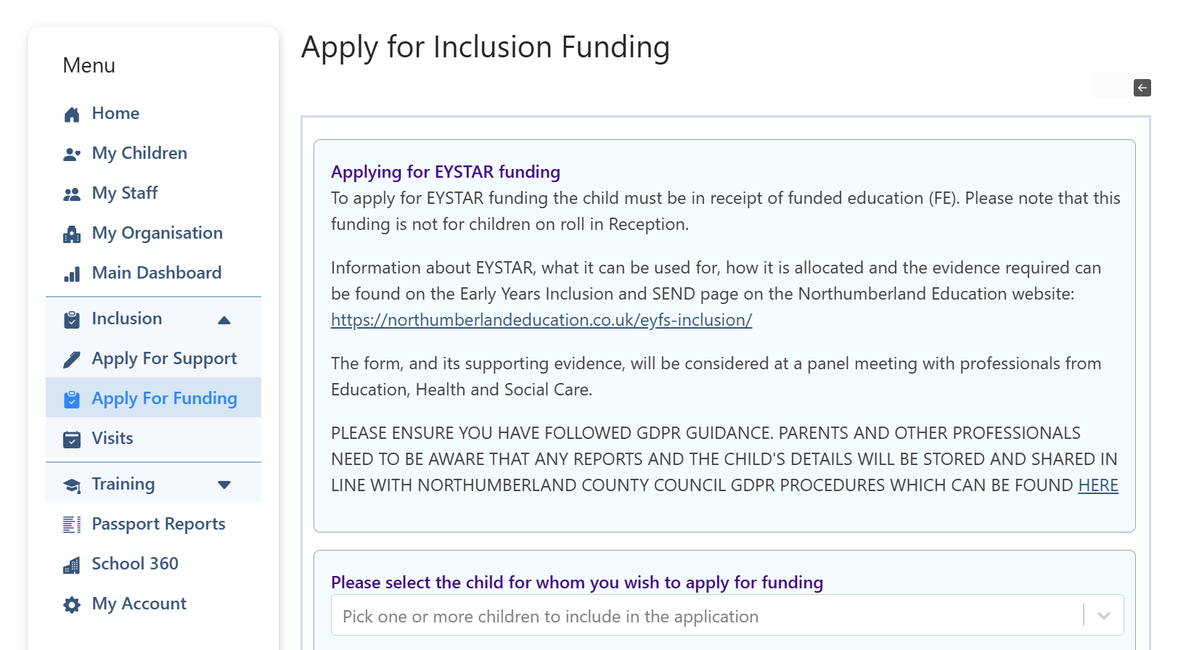
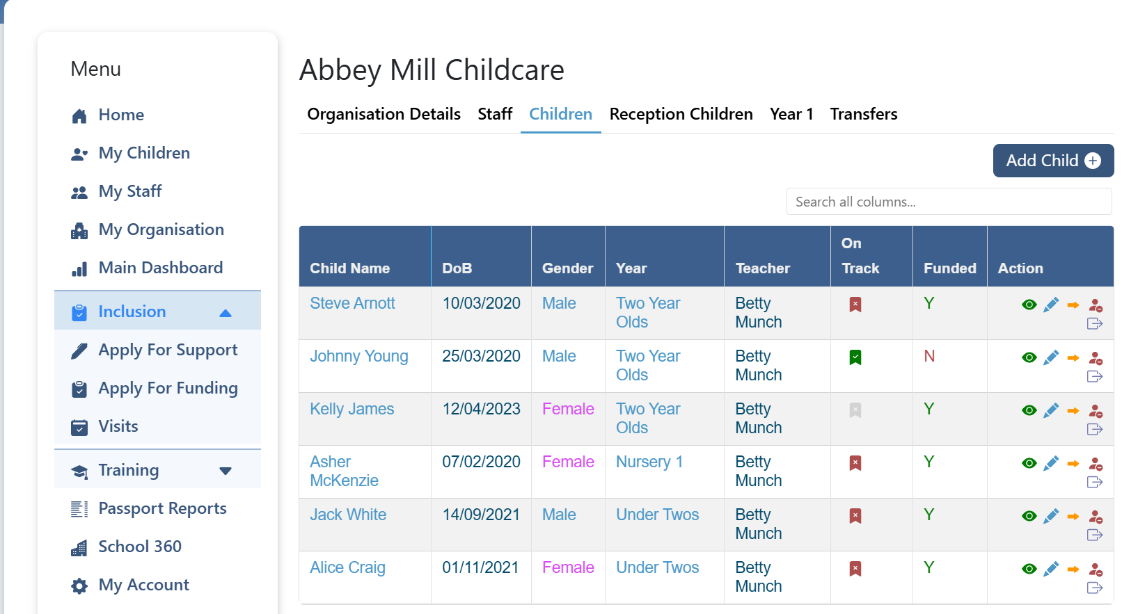
How to request EYSTAR
Before starting – please ensure that the child you are requesting EYSTAR for has been seen by an EY Inclusion Consultant. (If not please see - how to request inclusion support guidance video)
When you open your School Readiness Passport down the left-hand side you will see a drop-down option for inclusion.
Select 'apply for funding' and this will open the application form.

Slide 6
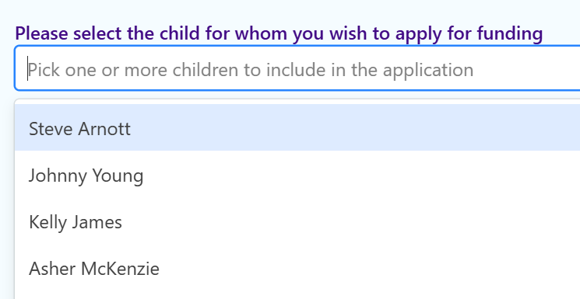
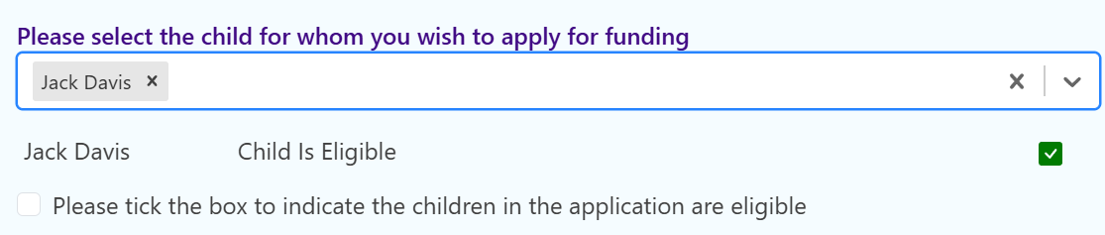
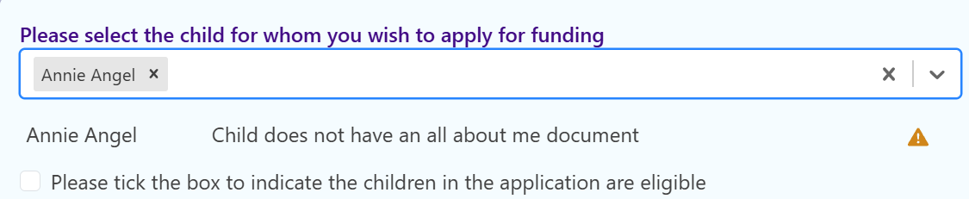
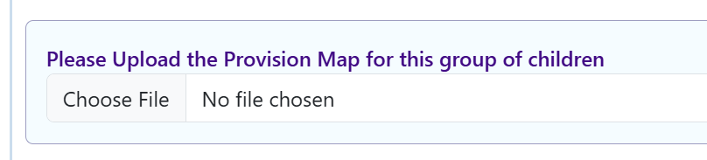
How to request EYSTAR cont.
You will then be able to select child/ren that you would like to request EYSTAR for. Please note if you are requesting group EYSTAR you need to apply for a minimum of 3 children.
The system will tell you if you have forgotten to upload any of the required documents.
If you are requesting EYSTAR for a group of children, you will be able to upload your provision map document here.

Slide 7
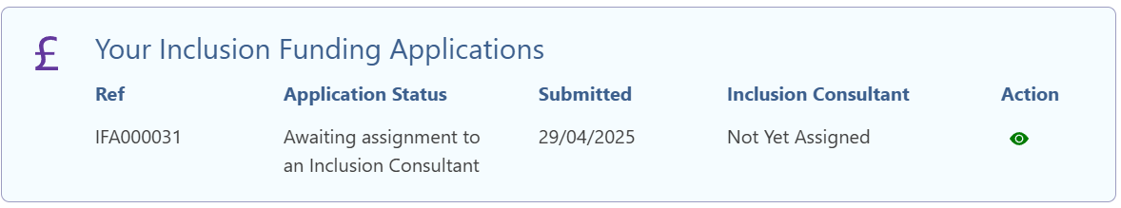
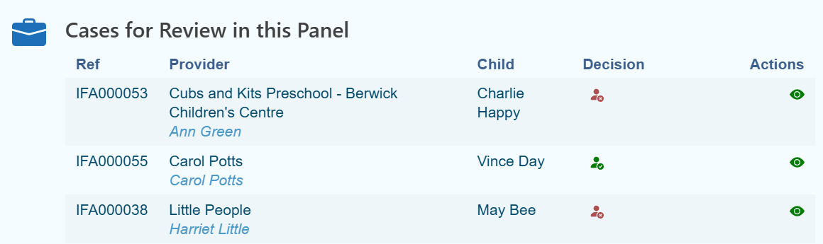
What happens next
On your home screen you will see the status of each EYSTAR application.
Once your EYSTAR request is submitted it will be allocated to an EYIC.
Once an EYIC has confirmed that all the necessary parts of the application have been completed, the application will be allocated to the next panel (see dates in guidance document).

Slide 8
Notification of Panel Process (all updates are provided through the School Readiness Passport)
Once you submit your application, you will receive a notification informing you of which panel your application has been allocated to.
Following the panel, your application will be confirmed as:
  EYSTAR allocated for a specific period of time
  Partial EYSTAR allocated
  No funding allocated
A letter confirming the details of your application will be uploaded to the child's documents within 72 hours of panel.

Slide 9
Reviewing EYSTAR Funding
PLEASE NOTE – You WILL NOT be reminded to review your EYSTAR funding. If you wish to review the funding, it is your responsibility to submit reviewed documentation to ensure no funding gaps. Funding will not be backdated if deadlines are missed.
You can review applications and reapply 10 weeks following the initial request. The School Readiness Passport will automatically allocate your new application to the appropriate panel based on dates (regardless of how early you apply).
Ensure that all documentation on the Passport is updated including reviewed family views, updated professional reports, and a further cycle of reviewed targets and a new cycle.
You can apply for a maximum of one round of EYSTAR funding per child, per term.
​

Slide 10
​ Appendix 1 – Points For consideration
​Applications | ​Possible Information Sources ​
​Have reasonable adjustments been made to enable this child to access their full early years entitlement? ​ | ​Cycles of targets Professionals' reports Early Years Inclusion Consultant visit reports Provision maps​ Actions
​Is this child accessing their full funded entitlement hours (where parents request it) to enable maximum gains of inclusive early years provision? If not and parents/carers would like them to, is there a clear plan in place to increase attendance? ​ ​ | ​Application Early Years Project Development & Business Manager reports Full entitlement plan
​Does evidence suggest that parents/carers have been involved in the assessment, planning and review process? ​ | ​Family views document​ Early Years Inclusion Consultant visit reports
​Does assessment information indicate that the child is not on track within the prime areas of learning? ​ | ​School Readiness Checker ​ Two Year Old Progress Integrated Review

Slide 11
​ Appendix 1 ​- Points for consideration
​Applications cont. | ​Possible Information Sources ​
​Do reports from other professionals suggest that the child would benefit from the requested level of additional funding? ​ | ​Professionals' reports
​Does the plan for supporting the inclusion of the child reflect the level of funding requested? ​ | Cycles of targets
​Are the strategies and approaches appropriate and in line with the good practice principles outlined in the EY Ordinarily Available Provision and is it clear that universal practice is well-embedded. | Cycles of targets Actions Early Years Inclusion Consultant visit reports
​Are the strategies and approaches implemented appropriate and in line with those recommended by professionals involved with the child? | Cycles of targets Early Years Inclusion Consultant visit reports Professionals' reports Actions

Slide 12
​ Appendix 1 ​- Points for Consideration
​Applications cont. | ​Possible Information Sources ​
​Has the provider used transition systems effectively to share/gather information about the child and the inclusive strategies and approaches which are effective in meeting their needs? ​ | School Readiness Passport transfers Reports shared by previous providers ​
​For children attending more than one setting, is there evidence to suggest that providers are working in partnership to provide a holistic approach to supporting the needs of the child through consistent inclusive practices? ​ | Cycles of targets Early Years Inclusion Consultant visit reports Joint/collaborative application

Slide 13
Appendix 1 - Points for consideration
Reviews | Possible Information Sources
What has the impact of targeted approaches (supported by the inclusion fund) been on the child’s progress? | Progress graph on SEND Support Checker School Readiness Checker Review visit from an Early Years Inclusion Consultant
If progress is slow, are the targeted approaches (and therefore the use of the additional funding) appropriate or do they need to be reviewed and modified? | Cycles of targets Professionals' reports
If progress is good and gaps are closing, can the level of targeted approaches in place (and therefore the level of inclusion fund) be reduced? Is there a plan to amend the level of targeted approaches in place, enabling the child to access entitlements through quality first teaching? | Progress graph on SEND Support Checker School Readiness Checker Cycles of targets

Slide 14
Appendix 1 – Points for consideration
Setting specific finance considerations
Has the setting used other funding streams (e.g. notional and Disability Access Fund) where appropriate to support inclusive practice and reasonable adjustments prior to making the application for EYSTAR?
Will this application supersede the setting’s limit for: No more than 30 hours funded support for a group of 13 or less 3/4 year olds or mixed age range? No more than 30 hours funded support for a group of 5 or less 2 year olds? No more than 30 hours funded support for a group of 3 under 2 year olds? £10K cap (per age range for large settings)?

Slide 15
Appendix 2 – Responsibilities
Local Authority responsibilities
The LA has a statutory duty to provide sufficient childcare where it is reasonably practical to do so before starting school or reaching school age. The LA has a statutory duty to meet the children’s individual education and care needs, ensuring that all providers delivering funded early education places meet the needs of children with Special Educational Needs and/or Disabilities.
Early Years provider responsibilities
The provider must adhere to the terms outlined in the Northumberland Early Years Provider Code of Practice, of which they have signed and agreed to in order to receive Funded Early Education Entitlement. The provider must comply with the Equality Act 2010. The provider should clearly state their SEND offer on FIS/Local Offer, communicating this with parents, carers and the wider community. The provider should have regard to the SEND Code of Practice (2015). Within this, providers are expected to:
Have a named SENDco.
Take a graduated approach to SEND.
The Assess, Plan, Do, Review cycle should be revisited in increasing detail and with increasing frequency, demonstrating evidence of SMART targets.
Involve parent/ carer(s) throughout the graduated approach, sharing all information on the support in place and reasoning, linking to desired outcomes. Parent/carer(s) must then be informed of any allocation of funding given to their child.

Slide 16
Appendix 3 – Eligibility
EYSTAR can be applied to children attending settings in Northumberland, regardless of where they live. Eligible children must be in receipt of a funded Early Years entitlement place.
Funding is only provided to the setting that makes the application (where a child attends more than one setting). Total amount paid will be proportionate to the number of funded hours the child takes at the provision who have applied for EYSTAR. However, where a child is attending more than one setting, settings are encouraged to work together to ensure the approaches and strategies implemented to support the child's targets are consistent.

Slide 17
Appendix 4 – Funding allocation
Eligibility and level of funding provided will be determined upon review of applications and supporting evidence by the Northumberland County Council EYSTAR Panel. The identified needs and the proposed outcomes of the child, as outlined by the provider, will determine the amount and allocation of funding.
In 2025-26, EYSTAR will be paid at £16.25 per hour minus the child's base rate. For example, an application for 7.5 hours of additional support for a child with 3-and 4-year-old funding would receive an additional £10.75 per hour for 7.5 hours per week for a 10-week period.
If the child attends the setting for more than 38 weeks of the year, it is up to the provider to choose whether they stretch the allocated EYSTAR funding.
Settings may apply for funding for multiple children as part of a group application. If this is appropriate it will be discussed with the Early Years Inclusion Consultant. In 2025-26, Group EYSTAR will be paid at an additional £16.25 per hour based on the support outlined on the requested provision map. For example, the provision map may outline that an additional staff member will be employed for 6 hours and 15 minutes per day to support 6 children. This would be allocated for a 10 week period.

Slide 18
Appendix 4 – Funding allocation cont.
Each provider’s budget allocation includes a notional budget for SEND (6% of the base rate). The notional budget is calculated by a funding formula and outlined in the Northumberland Early Years Code of Practice.
The funding should be used in a graduated response:
Providers are expected to provide high quality universal provision for all children.
Providers are expected to make reasonable adjustments to provision for those children who require additional support.
For those children who require additional support, over and above this, an application can be made for EYSTAR.

