Slide 1

Climate Action Plan support
Let’s Go Zero is the national campaign to help all education settings cut carbon, save money on their bills and make happier and healthier children. http://www.letsgozero.org/
We are running free workshops with the NLLT Early Years Hub and National Education Nature Park.
March 2nd 3:30-4:15pm online – Getting Started
March 9th 12:30-4:00pm in person Lighthouse View Workspace
You will leave these events with a completed Climate Action Plan covering all of the Department for Education pillars.
Decarbonisation
Adaptation & resilience
Biodiversity
Green skills & careers
Plus EYFS activity ideas from the National Education Nature Park.

Slide 2








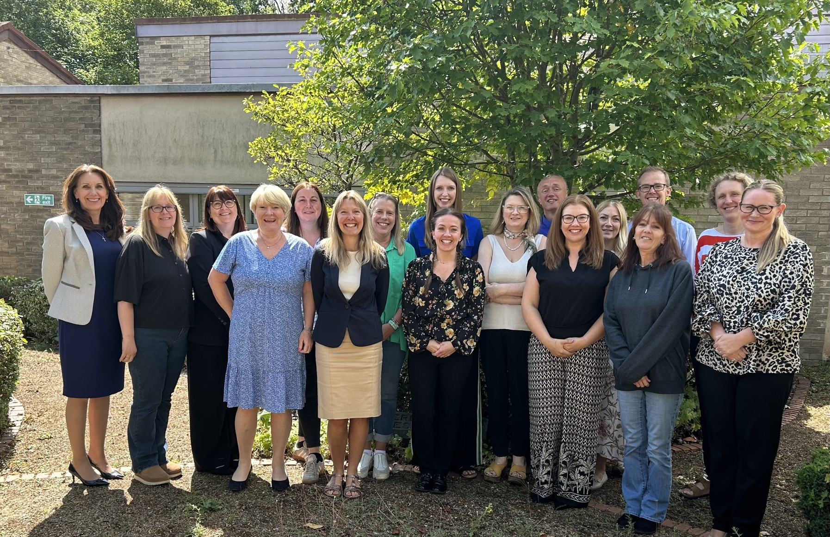




How Let’s Go Zero work with your nursery
www.letsgozero.org
We help you collect data so you can calculate your baseline carbon footprint
March 2nd 3:30pm online
Our initial “Getting you started” meeting
Free support to cut bills
We help you create your Climate Action Plan specific to your school or trust
March 9th 12:30pm Seaham
We support you to take action to reduce CO2e emissions

